Slide 1
Learning Objective
I will be able to solve problems involving arrangement [permutations] using the factorial notation
Success Criteria
At the end of the lesson, I will be able to:
understand factorial notation [ n! ] and how to evaluate simplify factorials;
understand the difference between repetitive and non repetitive notation in the context of arrangements;
be able to determine the number of arrangements for 𝑛 distinct items by using the multiplication principle; and
be able to solve problems involving arrangement [permutations] using the factorial notation.

Slide 2
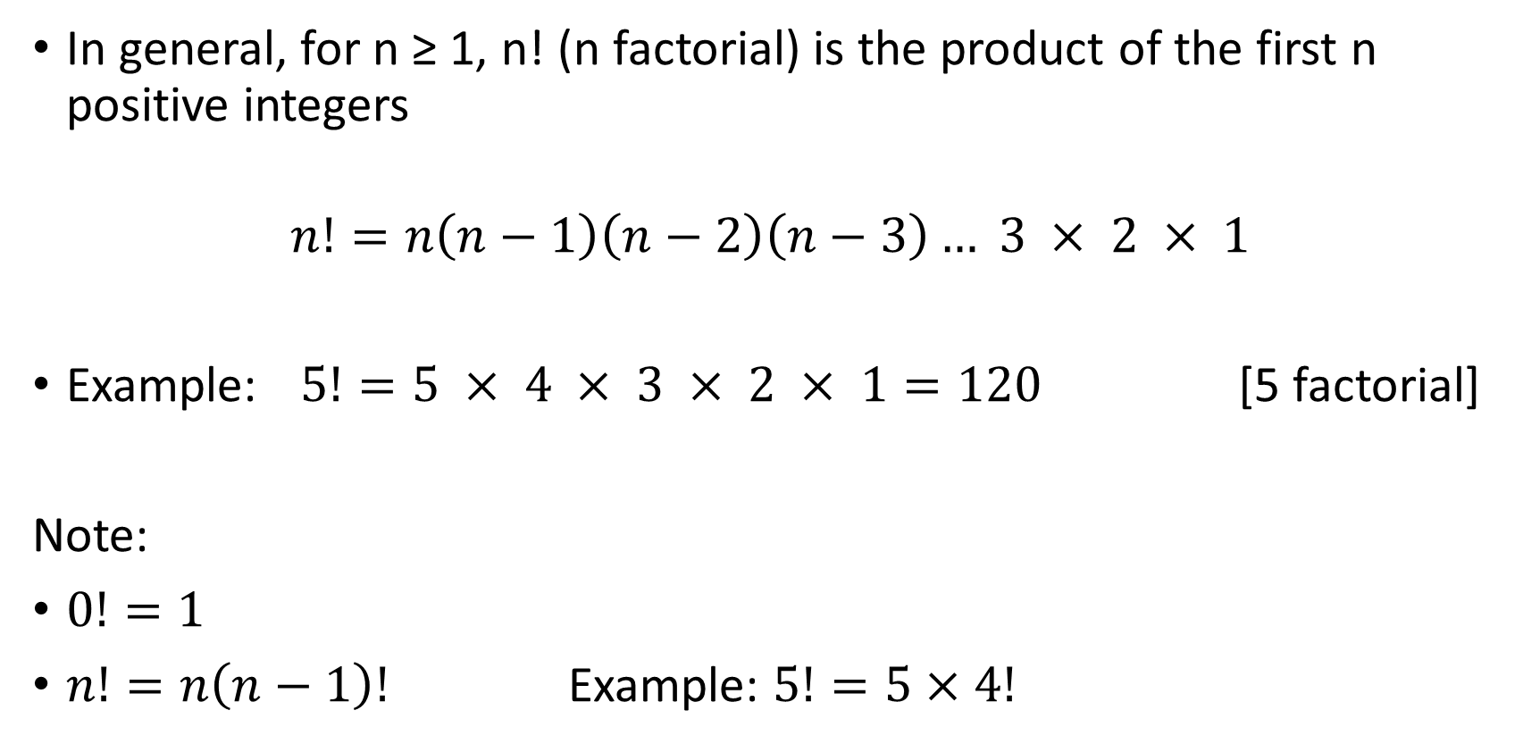
Factorial notation
Concept Development
In general, for n ≥ 1, n! (n factorial) is the product of the first n positive integers
$$n!=n\left(n−1\right)\left(n−2\right)\left(n−3\right)… 3 × 2 × 1$$
Example: $5!=5 × 4 × 3 × 2 × 1=120$ [5 factorial]
Note:
$0!=1$
$n!=n\left(n−1\right)!$ Example: $5!=5×4!$

Slide 3


Example
Guided Practice
$3!$
$\frac{8!}{5!}$
$\frac{11!}{8!3!}$
$3!=3 × 2 × 1=6$
$\frac{8!}{5!}=\frac{8 × 7 × 6 × 5 × 4 × 3 × 2 × 1}{5 × 4 × 3 × 2 × 1}=8 × 7 × 6=336$
$\frac{11!}{8!3!}=\frac{11 × 10 × 9 × 8!}{8! × 3 × 2 × 1}=\frac{11 × 10 × 9}{3 × 2 × 1}=165$

Slide 4
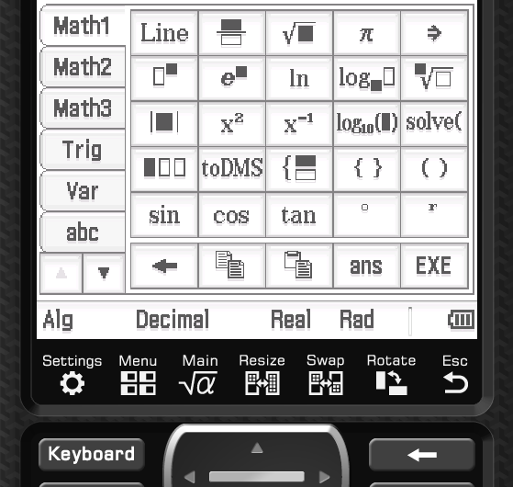
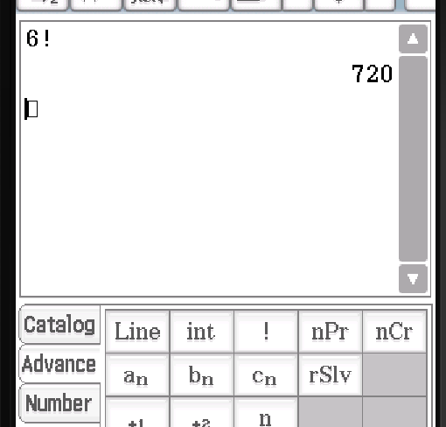






ClassPad
Factorial Notation
$$6!=$$
$$5!=$$
$$4!=$$
$$3!=$$
$$2!=$$
$$1!=$$

Slide 5

Permutations
Concept Development
Definition: The number of ways n objects can be arranged in a certain order.
Consider the following situation:
Justin has 5 books he wants to put on a shelf: Mathematics (M), Physics (P), English (E), Biology (B) and History (H). In how many ways can he do this?
No. of ways for to order books
Number of ways the books can be arranged: $$5×4×3×2×1=5!=60$$
1st
2nd
3rd
4th
5th
5
4
3
2
1

Slide 6


Guided Practice
In how many different orders can the names of 6 candidates be listed on a ballot paper for a local council election?
$$6×5×4×3×2×1=6!=720$$
How many different 3-digit numbers may be formed using only the digits 5, 7 and 9 where repeated digits are not permitted?
$$3×2×1=3!=6$$

Slide 7
Repetitive notation (index notation)
Concept Development
If you have a bag of 4 balls numbered with one to 4, you draw ball from the bag, note the number, put it back. Repeat the process many times.
In this case, every time you draw a ball, there are four possibilities.
Hence the possible arrangements is 4^{n} after you draw n^{th} times.

Slide 8
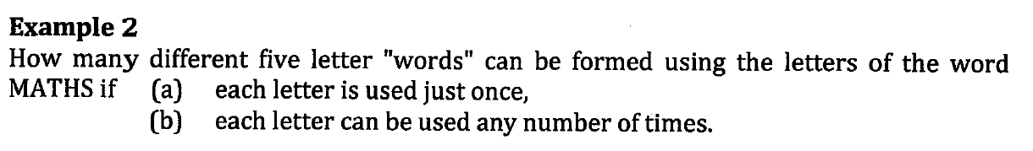
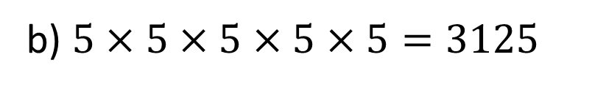
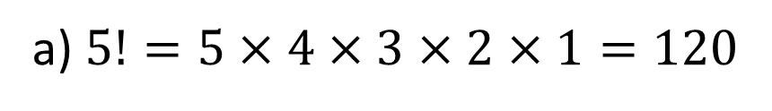
Guided Practice
a) $5!=5×4×3×2×1=120$
No. of ways for each letter
1st
2nd
3rd
4th
5th
5
4
3
2
1
No. of ways for each letter
b) $5×5×5×5×5=3125$
1st
2nd
3rd
4th
5th
5
5
5
5
5

Slide 9

Guided Practice
Mandy has to choose 4 optional subjects from a list of 12 for her college application. She has to write them in order of preference on her application form. How many different ways can Mandy complete the selection form?
1st
2nd
3rd
4th
$$12×11×10×9=11880$$
12
11
10
9

Slide 10
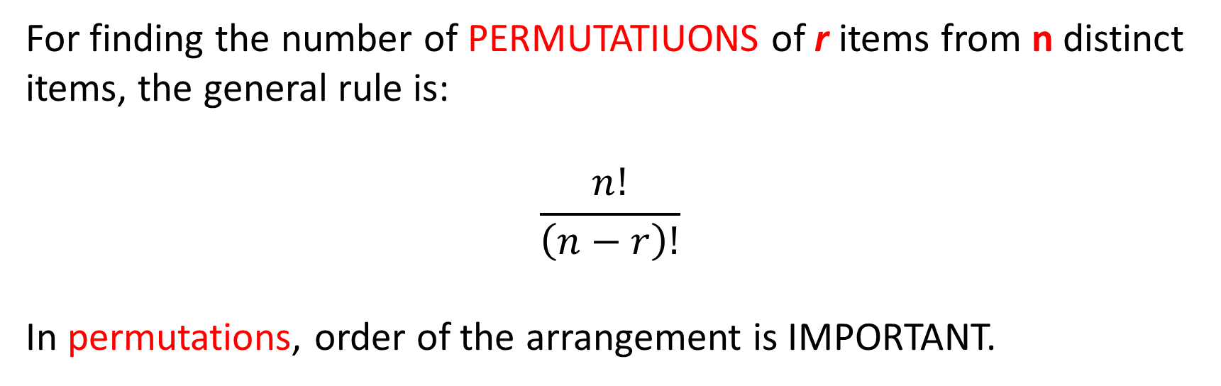

Permutations
Concept Development
For finding the number of PERMUTATIUONS of r items from n distinct items, the general rule is:
$$\frac{n!}{\left(n−r\right)!}$$
In permutations, order of the arrangement is IMPORTANT.

Slide 11

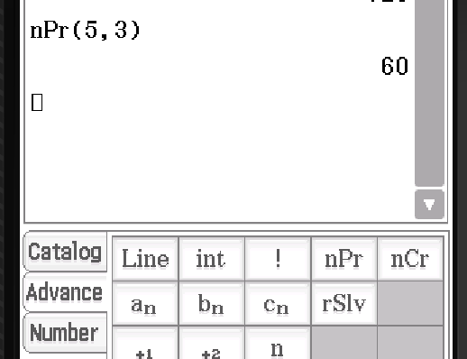
ClassPad
ClassPad

Slide 12
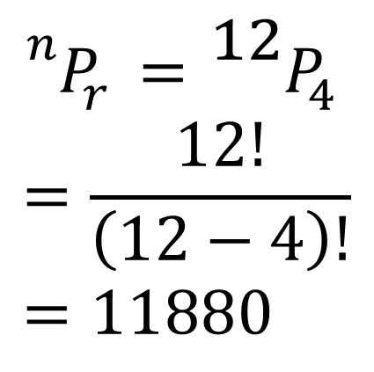
Guided Practice
Mandy has to choose 4 optional subjects from a list of 12 for her college application. She has to write them in order of preference on her application form. How many different ways can Mandy complete the selection form?
1st
2nd
3rd
4th
$${}_{ }^{n}{P_{r}}={}_{ }^{12}{P_{4}} \\ =\frac{12!}{\left(12−4\right)!} \\ =11880$$
12
11
10
9

Slide 13
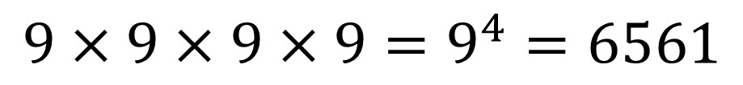
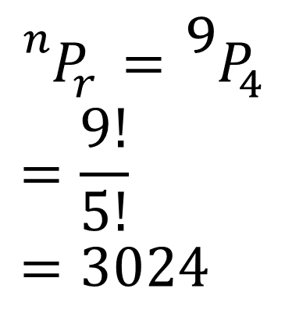
Guided Practice
Find the number of different four – digit numbers that can be formed from the digits 1 – 9, if each digit can only be used: a) only once
b) More than once
$${}_{ }^{n}{P_{r}}={}_{ }^{9}{P_{4}} \\ =\frac{9!}{5!} \\ =3024$$
$${9×9×9×9=9}^{4}=6561$$

Slide 14
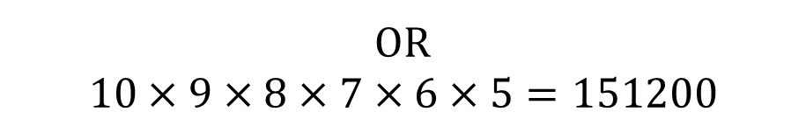
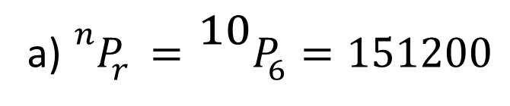
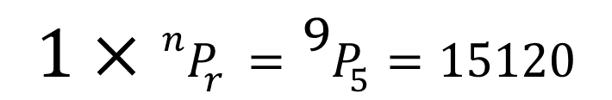
Guided Practice
Mark wants to set up his pin number (6 digits) for his credit card from the 0 to 9. He does not want to repeat any numbers.
How many ways can he set up his pin numbers?
If he wants the first number to be 2, how many ways can he set up his pin number now?
a) ${}_{ }^{n}{P_{r}}={}_{ }^{10}{P_{6}=151200}$
1st
2nd
3rd
4th
5th
6th
1
9
8
7
6
5
OR
$$10×9×8×7×6×5=151200$$
$$1×{}_{ }^{n}{P_{r}}={}_{ }^{9}{P_{5}=15120}$$

Slide 15

Guided Practice
How many different even four-digit numbers can be formed from the digits 1 – 8, if each digit may be used only once?
1st
2nd
3rd
4th
7
6
5
4
$$7×6×5×4=840$$

Slide 16



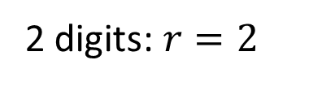


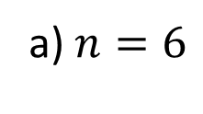



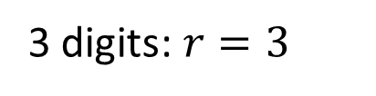

Guided Practice
If no digit can be used more than once, find how many numbers that can be formed from the digits 3, 4, 5, 6, 7, 8 are:
Two – or three- digit numbers
Six-digit numbers and even
Greater than 7000
1st
2nd
3rd
4th
5th
6th
a) $n=6$
5
4
3
2
1
3
2 digits: $r=2$
b) $5×4×3×2×1×3=360$
$${}_{ }^{6}{P_{2}}=30$$
1st
2nd
3rd
4th
3 digits: $r=3$
c) 4 digits:
$${}_{ }^{6}{P_{3}}=120$$
2
5
4
3
$${}_{ }^{6}{P_{2}}+{}_{ }^{6}{P_{3}}=150$$
$$2×5×4×3=120$$
5 digits:${}_{ }^{6}{P_{5}}=720$
$$6!=720$$
Total:$120+{}_{ }^{6}{P_{5}}+6!=1560$

Slide 17
Independent Practice
Complete Ex 10B

